Slide 1
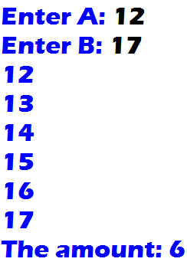

1. Given two integers A and B (A < B), output in ascending order all integers in the range A to B (including A and B). Also output the amount N of these integers.
Output

Slide 2
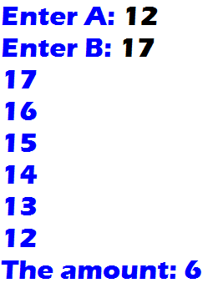
2. Given two integers A and B (A < B), output in descending order all integers in the range A to B (including A and B). Also output the amount N of these integers.
Output

Slide 3
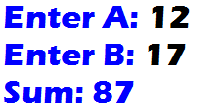
3. Given two integers A and B (A < B), find the sum of all integers in the range A to B inclusive.
Output
12 + 13 + 14 + 15 + 16 + 17 = 87

Slide 4
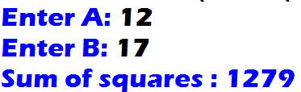

4. Given two integers A and B (A < B), find the sum of squares of all integers in the range A to B inclusive.
Output
${12}^{2}$ + ${13}^{2}$ + ${14}^{2}$ + ${15}^{2}$ + ${16}^{2}$ + ${17}^{2}$ = 1279

Slide 5

5. Given two integers A and B (A < B), find the product of all integers in the range A to B inclusive.
Output
12 * 13 * 14 * 15 * 16 * 17 = 8910720

Slide 6
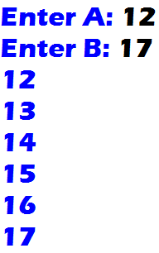
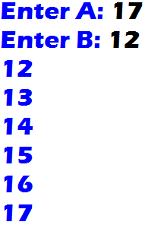
6. Given two integers A and B , output those integers from the smallest to the largest.
Output

Slide 7
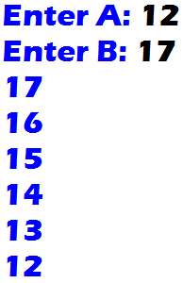
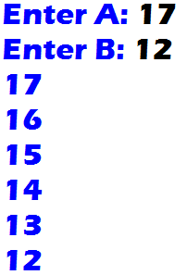
7. Given two integers A and B , output those integers from the largest to the smallest.
Output

